Slide 1

Intro to NServiceBus
8 – WCF Integration

Slide 2
Interoperation
NServiceBus is tied fairly tightly to .NET based applications
It generally requires MSMQ on a local system
So, think of the following… How can I get Javascript in a web page to send a message to NServiceBus running in a data center?

Slide 3
This can be done fairly easily
Any NServiceBus Endpoint can be exposed as a WCF Service
That WCF Service can have any WCF binding, such as JSON over HTTP.
Therefore, expose your NServiceBus endpoint as a JSON over HTTP WCF Service, and you can now to things like send orders from a web page to NServiceBus
NserviceBus can then do the heavy lifting or coordinating other systems to get that done

Slide 4
How to?
Declare your WCF service contract and messages
Declare a Service using NServiceBus.WcfService
Create a handler for the WCF message
Do a little config file magic to setup WCF
And send messages to the NServiceBus endpoint just like its WCF
Caveat emptor: you send a message, but you really only get a success or failure response

Slide 5
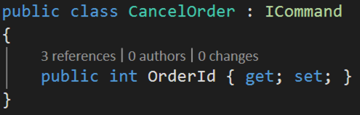
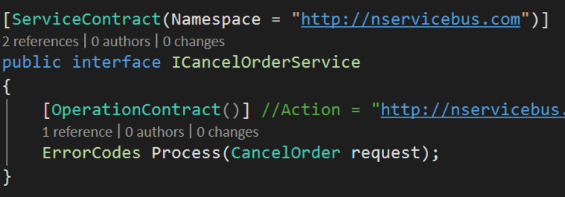
Declare your WCF service contract and messages

Slide 6
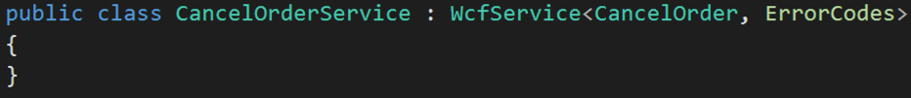
Declare a Service using NServiceBus.WcfService

Slide 7
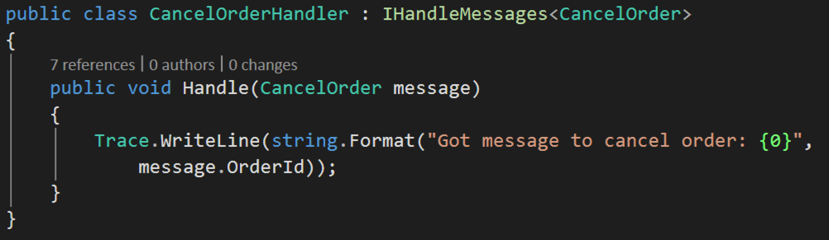
Create a handler for the WCF message

Slide 8
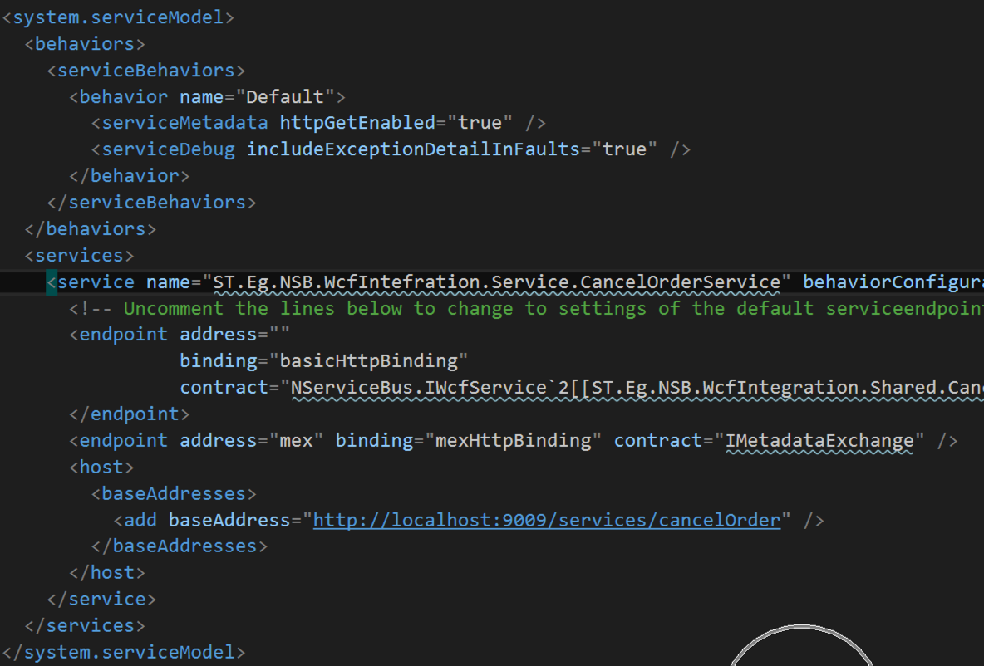
Do a little config file magic to setup WCF

Slide 9
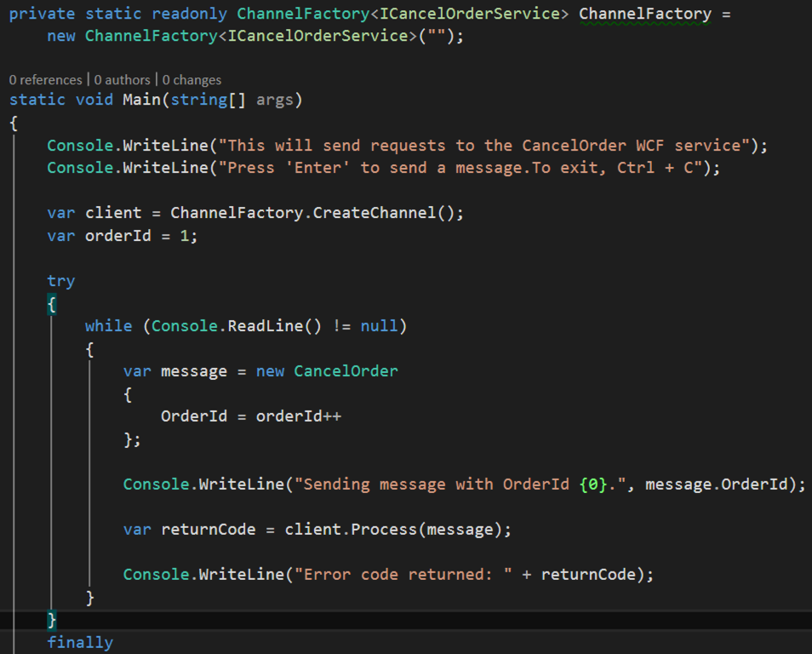
And send messages to the NServiceBus endpoint just like its WCF

Slide 10
Woot!

Slide 11
Still an issue though…
We can send stuff this way, but we don’t get anything back.
If we believe in the C in CQRS, then this is ok
We can do things such that pub sub replies or request reply responses are routed to a gateway NServiceBus Service
That gateway service will then send those message via WebSocket / SignalR back to the original source!

Slide 12
Demo: WCF Integration

